Slide 1


COMPUTER GRAPHICS PROJECT
P A R K I N G

Slide 2
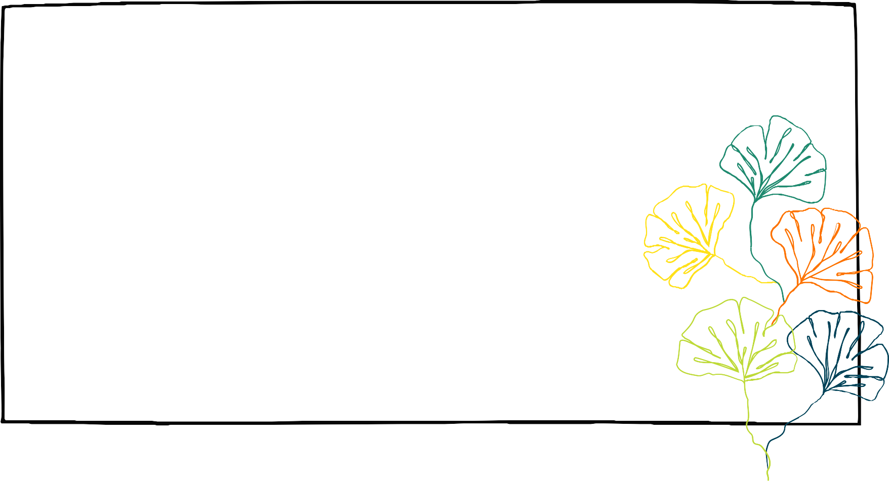
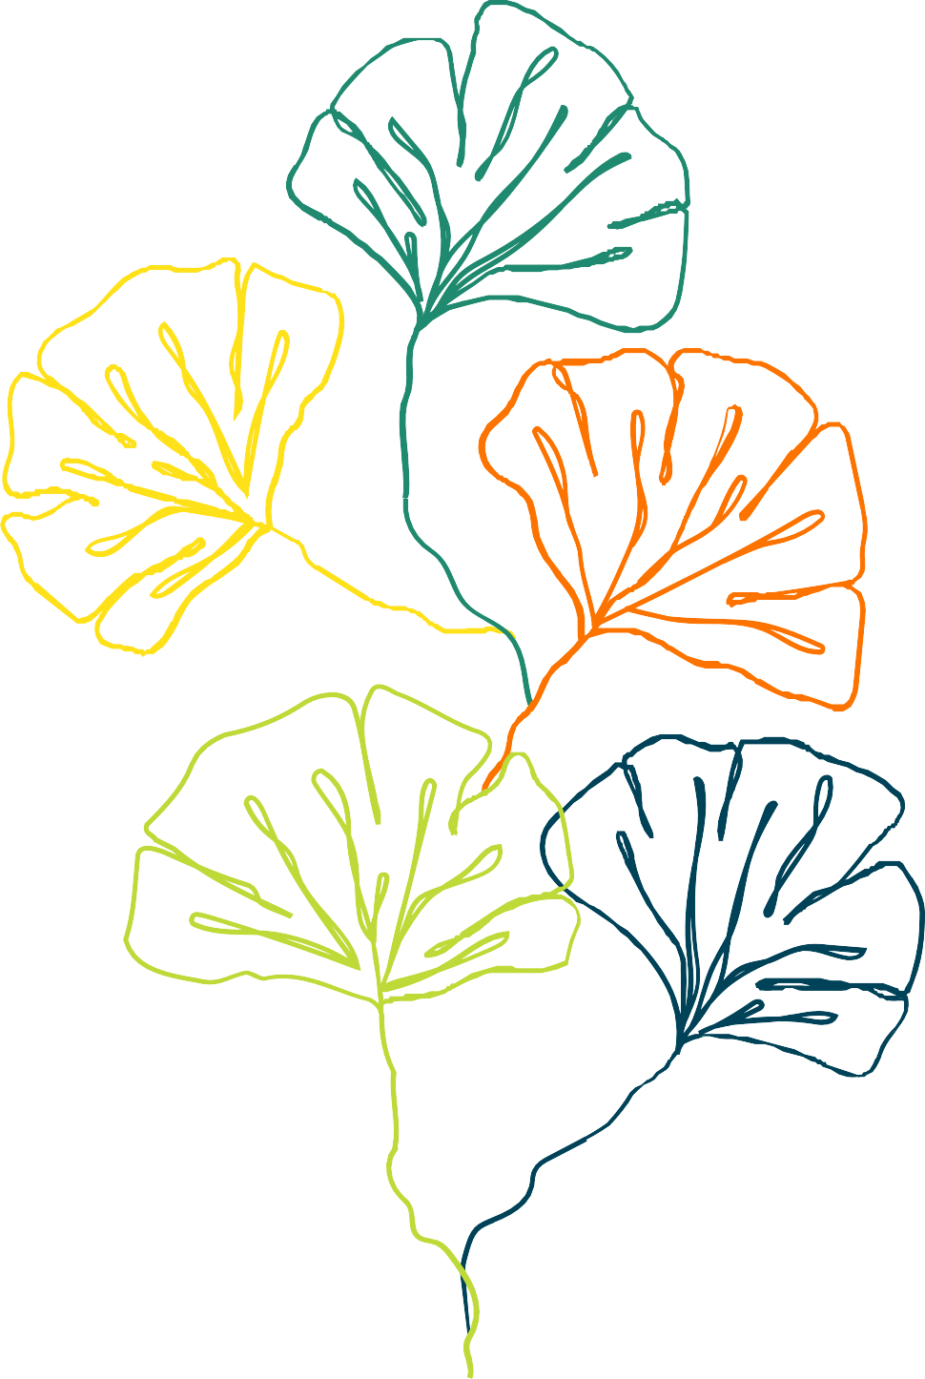
Computer Graphics
23163401-3.
Dr. Tarik Alafif.
27.may.2022

Slide 3
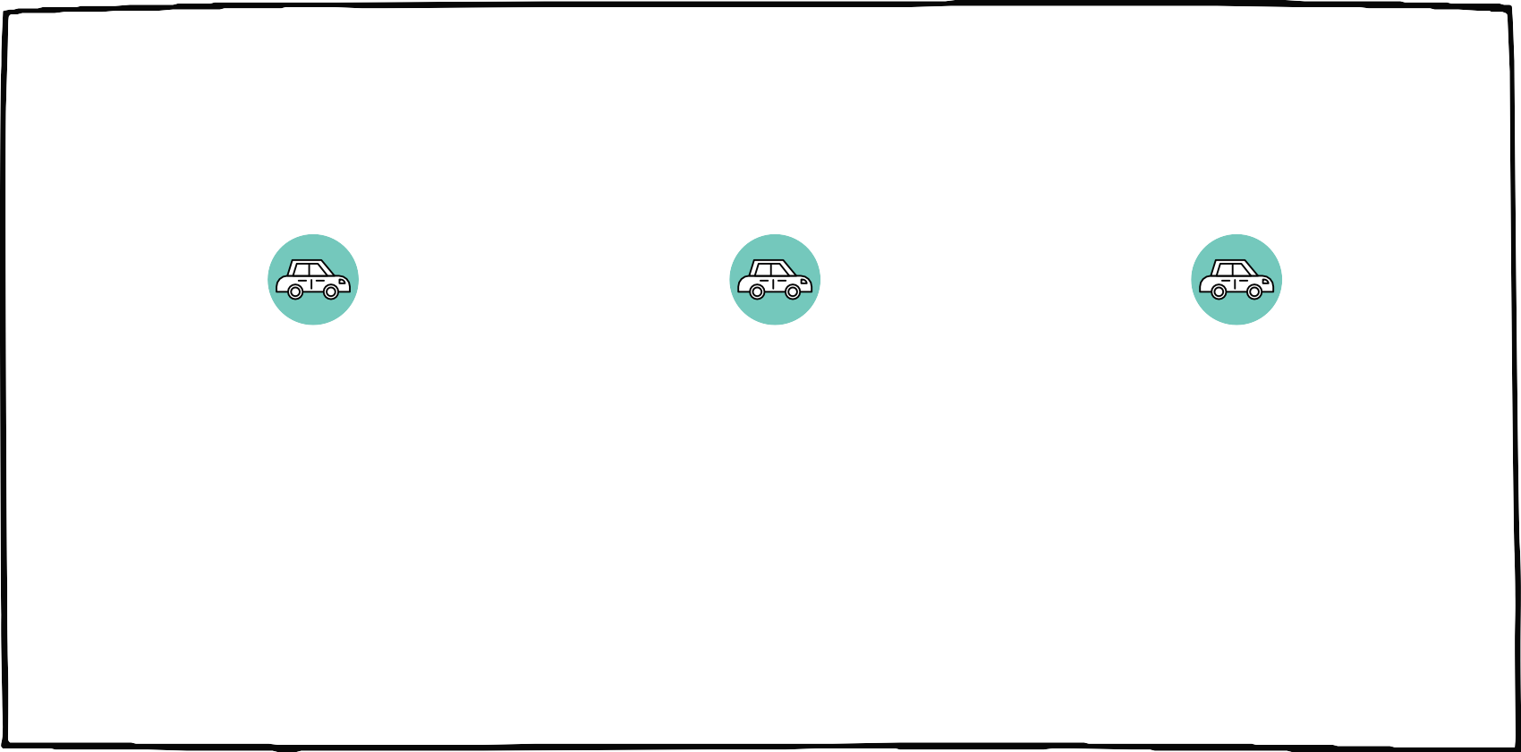
MEET OUR GROUP
A H D A B A L B I S H R I
G H A L A G H U F U R I
D A N A H A L - H A R B I

Slide 4

Abstract
In this presentation you will give a brief about our computer graphics project We use c++ language to build our project.
This project about trying to drawing a simple parking of cars. This park contain static and moving cars.
We want to explain our work in stages and put screenshots of outputs.

Slide 5
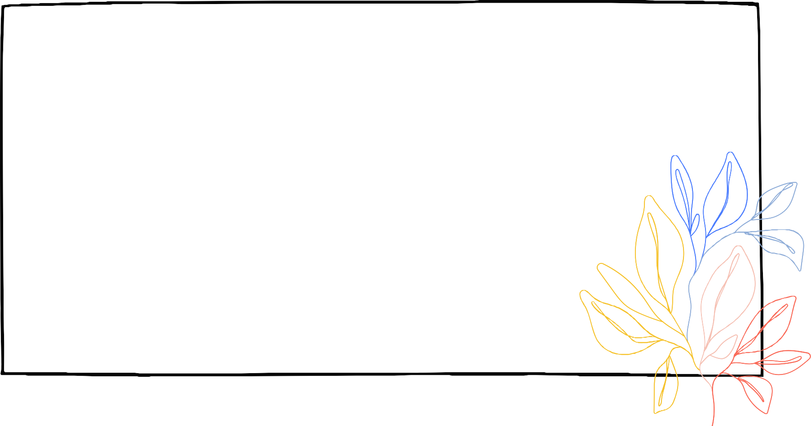
Introduction
By using c++ graphics library we can doing a simple show. Our project is about drawing a parking of cars using graphics library and things that we learn from the course and our instructors.

Slide 6

Methodology
Firstly we fill the ground with gray color and by using rectangles we spilt the ground to five places.
Then we start by drawing a cars.
Each car constructed by two rectangles and two circles. And we fill each car with different color.
After that and by the same thing we draw moving car.

Slide 7

Methodology
We use flood fill to fill objects with colors.
We use circleMidpoint(x,y,r) algorithm to draw circles of (x,y) as center and r as radius.
We use rectangle(x1,y1,x2,y2) method from graphics library to draw rectangle of (x1,y1) as start point and of (x2,y2) as end point.
Finally We use for loop and edit the position of moving car to get the move effect.

Slide 8
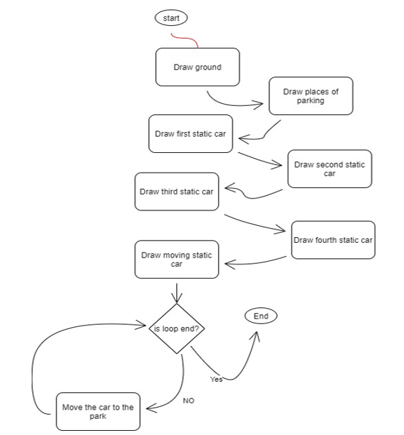

flow chart

Slide 9
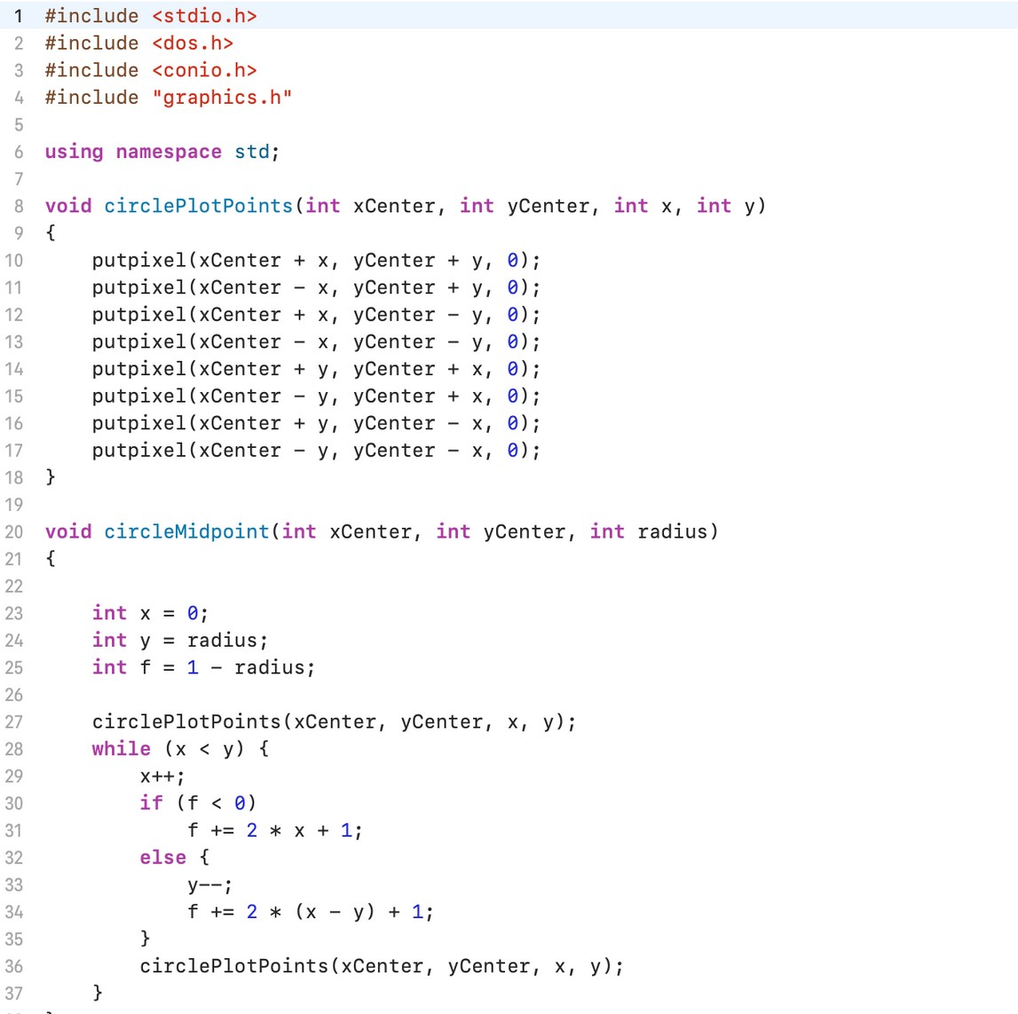

Algorithm

Slide 10
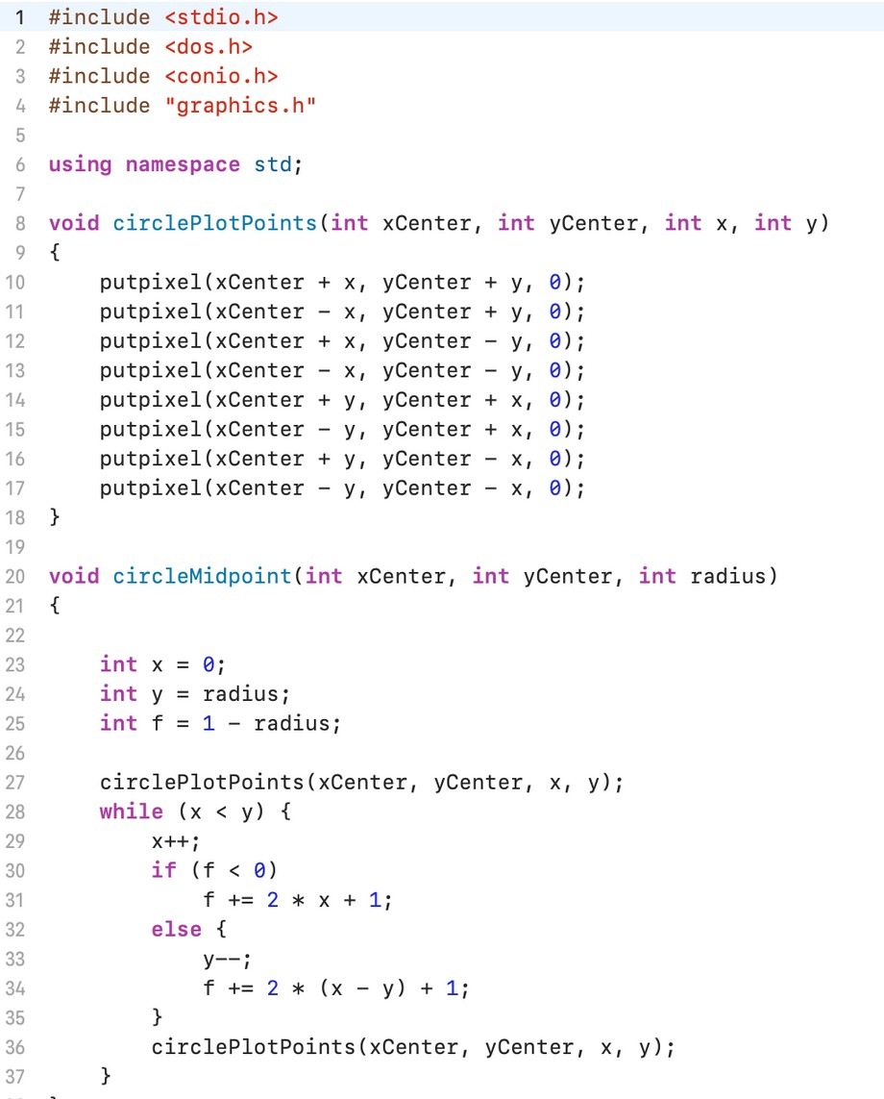
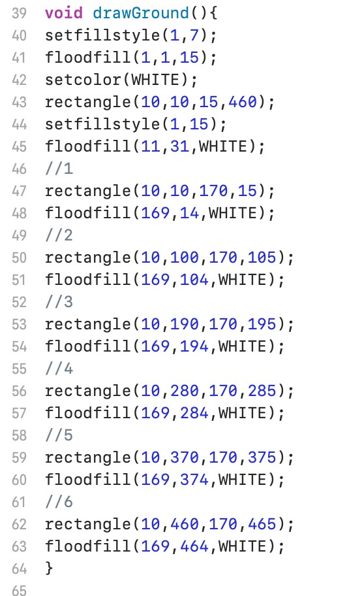

Our code

Slide 11
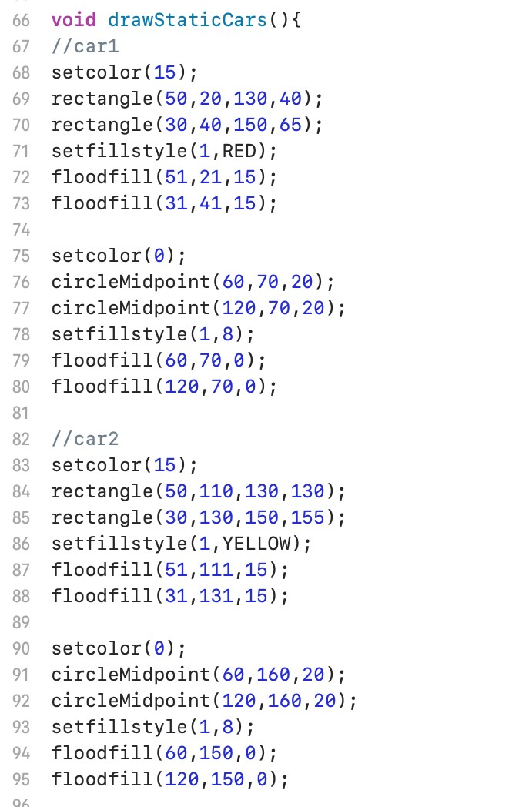
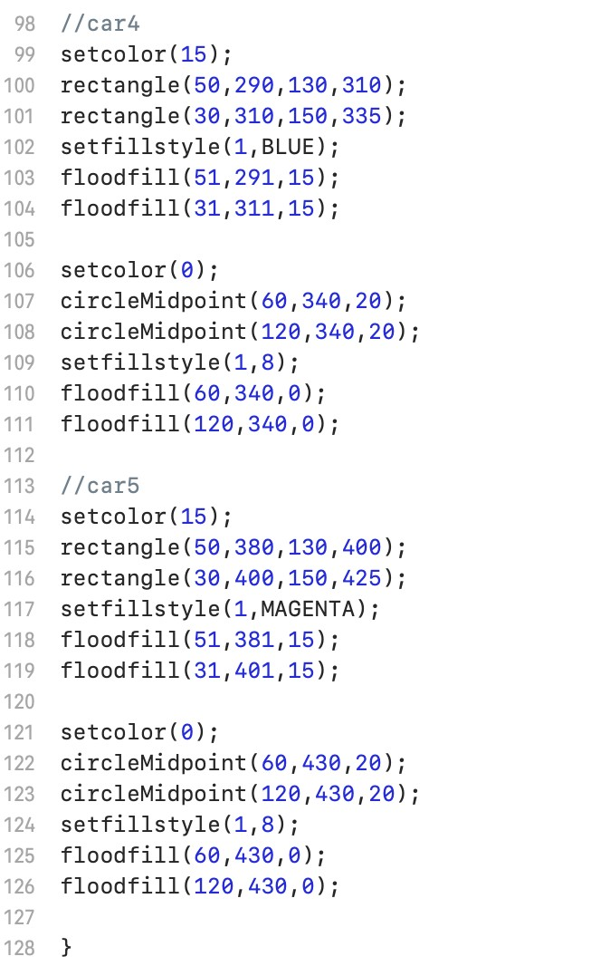
Our code

Slide 12
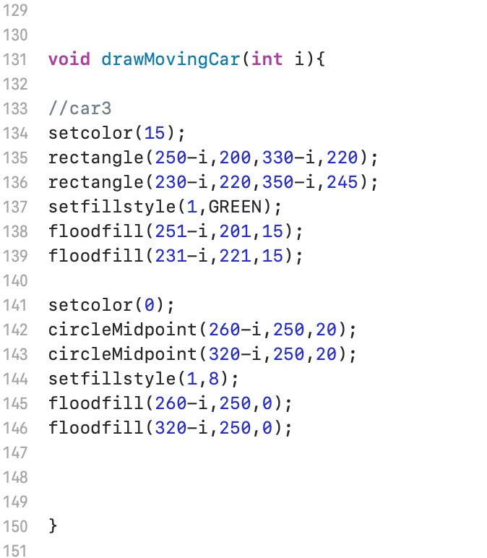
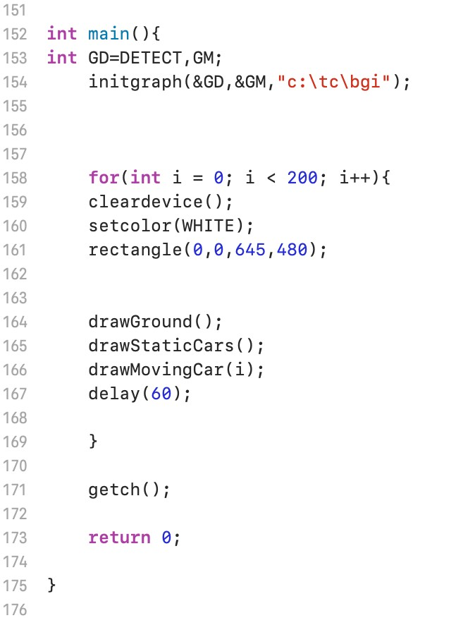
Our code

Slide 13
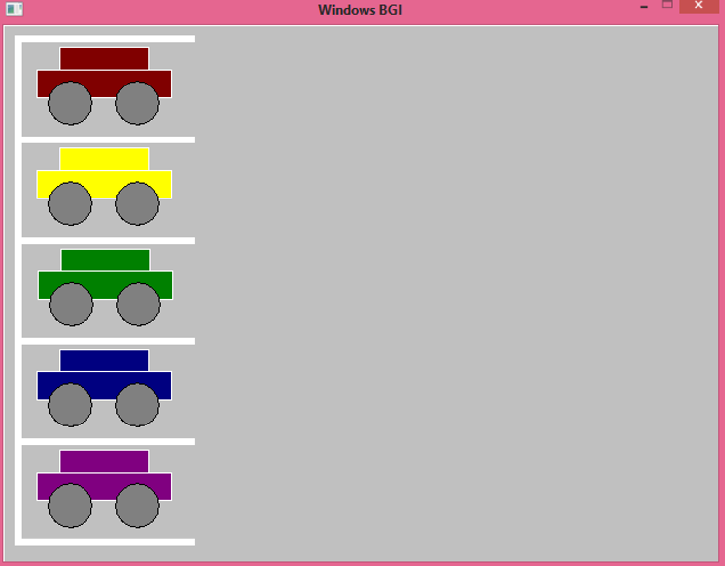
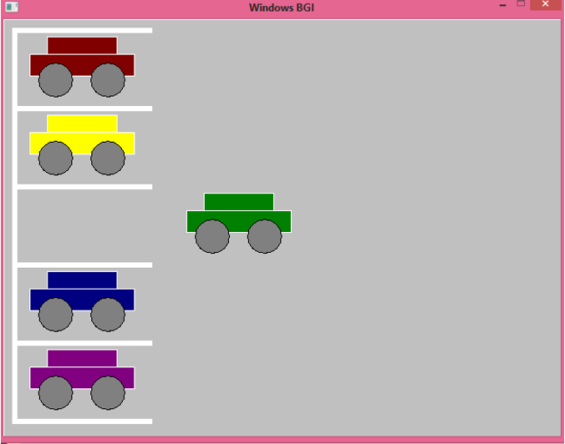
OutPut

Slide 14
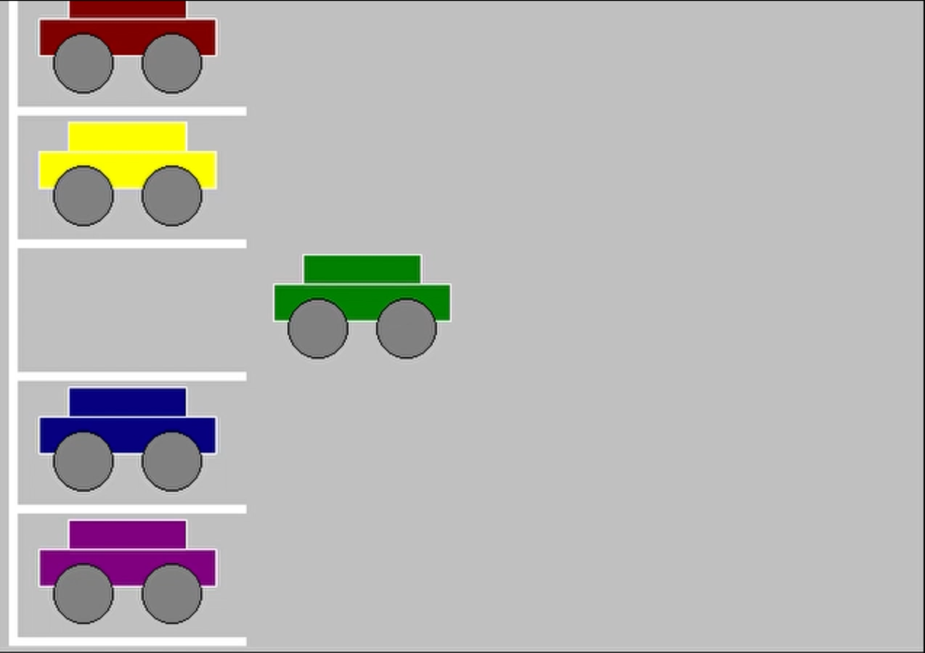
OutPut

Slide 15
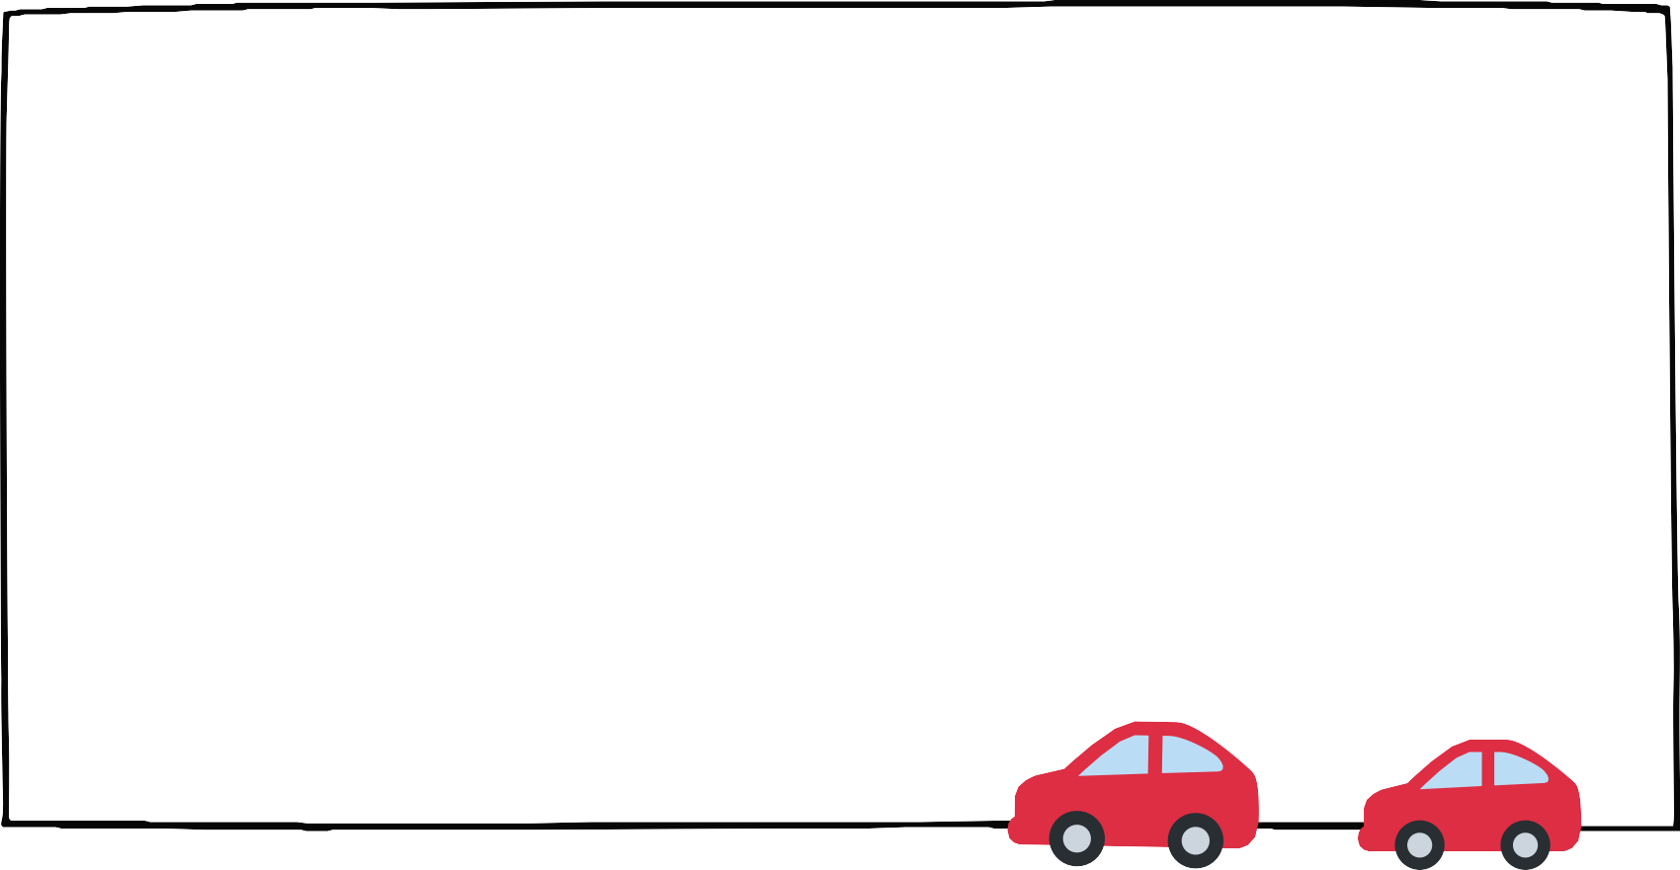
Conclusion
In this presentation we have introduced a simple computer graphics project using the c++ programming language especially the graphics library. We explain how we create our project in steps.
We document each stage of our work with screenshots and finally we get the final result.
We hope that we doing an useful project.
In future we going to add more shapes to our project and we going to make the cars better.

